Slide 1


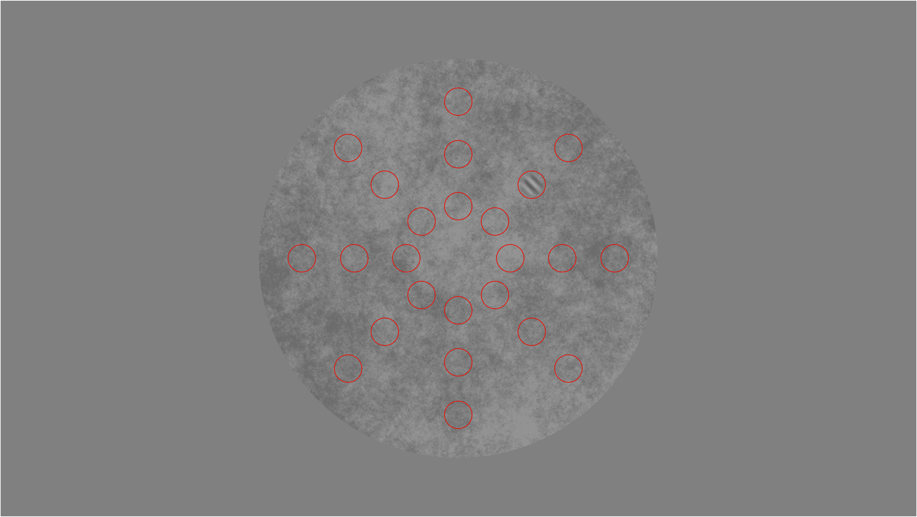

Invisible task space
Correct feedback
Trial-by-trial randomized 1/f noise
2°
Press
M
1/3°
15°
4°
v1b
Fixed position (invisible)
v1a
Adapted from: Najemnik, 2005, Nature
v2

